Slide 1
Data Mining
Association Rules
Mr. SHIVAM PANDEY
N.I.T.,WEST BENGAL
Mr. Shivam Pandey

Slide 2
Association Rules:-
Let A = {l₁,l₂,.. …, l_{m}} be a set of items. Let T, the transaction database be a set of transactions, where each transaction t is a subset of items. Thus t is a subset of A.
Definition:- Support: A transaction t is said to support an item l_{l}, if l_{l} is present it t. t is said to support a subset of items X ⊆A, if t supports each item l in X. An item set X ⊆ A has a support s in T, denoted by S(X)_{T} , if s% of transactions in T support X.
Mr. Shivam Pandey

Slide 3
Let us consider the set of transactions in a bookshop as shown in the next slide
We shall look at a set of only 6 transactions of purchases of books. In the first transaction, purchases are made of books on Compiler Construction (CC), Databases (D), Theory of Computations (TC), Computer Graphics (CG), and Artificial Neural Networks (ANN); We shall denote these subjects by CC, D, TC, CG and ANN, respectively. Thus we describe transactions as follows:
Mr. Shivam Pandey

Slide 4
Fig. 1
t₁ = {ANN, CC, TC, CG}
t₂ = {CC, D, CG}
t₃ = {ANN, CC, TC, CG}
t₄ = {ANN, CC, D, CG}
t₅ = {ANN, CC, D, TC, CG}
t₆ = {CC, D, TC}
So A = {ANN, CC, D, TC, CG} and
T = {t₁, t₂, t₃, t₄, t₅, t₆}
Mr. Shivam Pandey

Slide 5
We can see that t₂ supports the items CC, D and CG. The item D is supported by 4 out of 6 transactions in T. Thus the support of D is 66.6%.
Association Rule: For a given transaction database T, an association rule is an expression of the form X ⇒ Y, where X and Y are subsets of A and X ⇒ Y holds the confidence τ, if τ% of transaction in T that support X also support Y. The rule X ⇒ Y has support σ in the transaction set T if σ% of transactions in T support X U Y
Mr. Shivam Pandey

Slide 6
Consider the example of the bookshop. Assume that σ = 50% and τ = 60%. Clearly ANN ⇒ CC holds. The confidence of this rule is, 100% because all the transactions that support ANN also support CC. On the other hand, CC ⇒ ANN also holds, but its confidence is 66%
Mr. Shivam Pandey

Slide 7
Problem Decomposition
Find all sets of items, whose support is greater than the user specified minimum support, σ. Such item sets are called frequent item sets.
Use the frequent item sets to generate the desired rules. The general idea is that if, say ABCD and AB are frequent item sets, then we can determine if the rules AB ⇒ CD holds by checking the inequality shown in the next slide:
Mr. Shivam Pandey

Slide 8
s({A,B,C,D}) ≥ τ
s({A,B})
Where s(X) is the support of X in T.
Mr. Shivam Pandey

Slide 9
Definitions
Let T be the transaction database and σ be the user specified minimum support. An itemset X ⊆ A is said to be a frequent itemset in T with respect to σ, if
s(X)_{T} ≥ σ
In Example of Fig. 1, if we assume σ = 50%, then {ANN, CC, TC} is a frequent set as it is supported by at least 3 out of 6 transactions. We can see that any subset of this set is also a frequent set. On the other hand {ANN,CC,D} is not a frequent itemset and hence no set which properly contains this set is also a frequent set.
Mr. Shivam Pandey

Slide 10
Definitions
Maximal Frequent Set: A frequent set is a maximal frequent set if it is a frequent set and no superset of this is a frequent set.
Border Set: An itemset is a border set if it is not a frequent set, but all its proper subsets are frequent sets.
Note that if we know the set of all maximal frequent sets of a given T with respect to a σ, then we can find the set of all frequent sets without any extra scan of the database. Thus the set of all maximal frequent sets can act as a compact representation of the set of all frequent sets.
Mr. Shivam Pandey

Slide 11
We shall often refer to the lattice of subsets of A as shown in Fig. 2. For example, if A = {a,b,c,d,e}, then the lattice is given the following figure. In this lattice, the set of maximal frequent sets acts as a boundary between the set of all frequent sets and the set of all infrequent sets.
Mr. Shivam Pandey

Slide 12
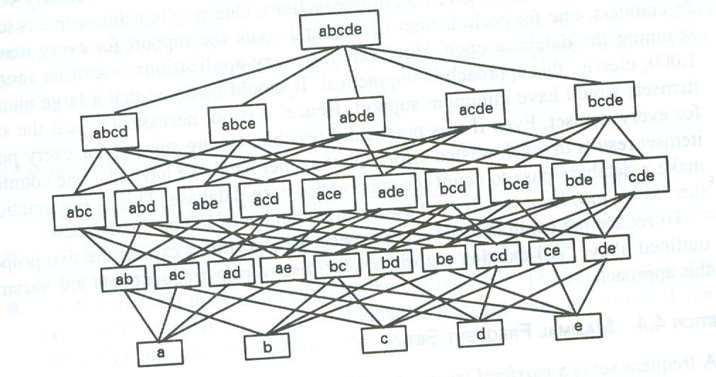
Fig. 2
Mr. Shivam Pandey

Slide 13
See Fig. 3 in the next slide
A = {A1,A2,A3,A4,A5,A6,A7,A8,A9}. Assume σ = 20%. Since T contains 15 records, it means that an itemset that is supported by at least three transactions is a frequent set.
Mr. Shivam Pandey

Slide 14
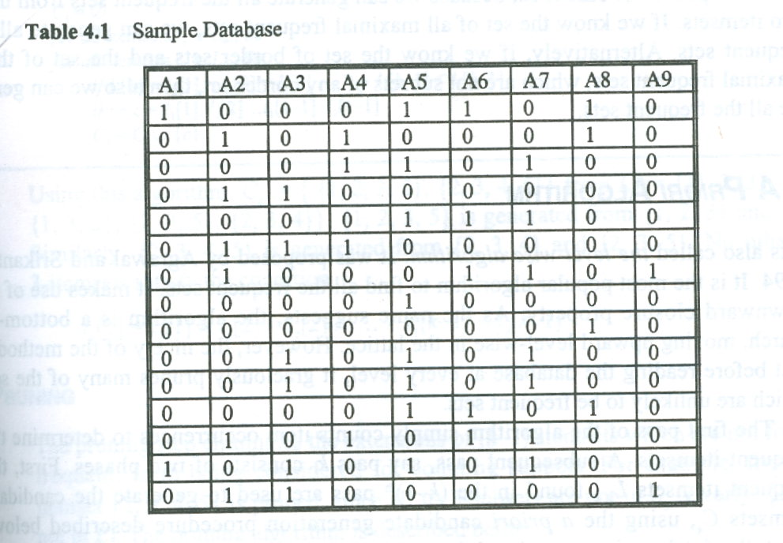
Fig. 3
Mr. Shivam Pandey

Slide 15
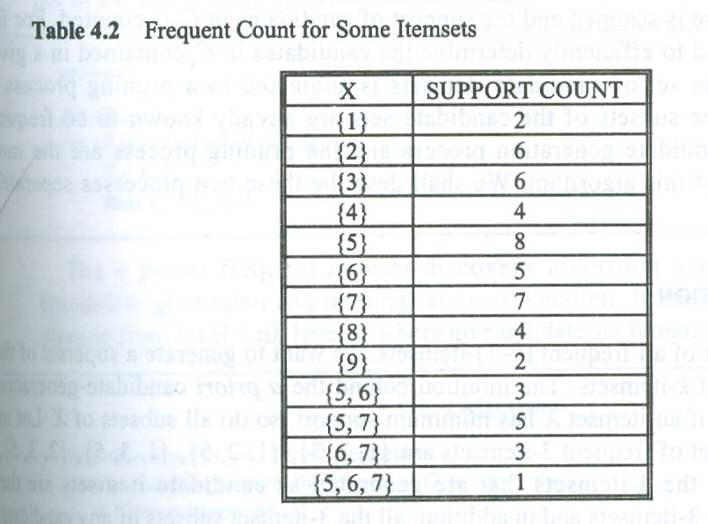
Fig. 4
Mr. Shivam Pandey

Slide 16
Applications of Data Mining – a close viewpoint
Several important data mining applications are concerned with pattern detection and recognition.
Spotting fraudulent behavior by detecting regions of space defining different types of transactions, where the data points significantly differ from the rest.
Astronomy: Another use is in astronomy, where detection of unusual stars or galaxies or nebulas or super galaxies may lead to the discovery of previously unknown phenomena and terrestrial body.
Mr. Shivam Pandey

Slide 17
Applications of Data Mining contd..
3. Another Task: Finding combinations of items that occur frequently in transaction databases
Mr. Shivam Pandey

Slide 18
Association Rules
An association rule is a simple probabilistic statement about the co-occurrence of certain events in a database.
An association rule takes the following form:
If A = 1 and B = 1 THEN C = 1 with probability p
Mr. Shivam Pandey

Slide 19
Where A, B, and C are binary variables and p = p(C =1 | A =1, B =1), i.e. the conditional probability that C = 1 given that A = 1 and B = 1.
The conditional probability p is sometimes referred to as the ‘accuracy’ of ‘confidence’ of the rule.
Mr. Shivam Pandey

Slide 20
Informal a priori Algorithm for Association Rule Learning
In general we moves from frequent sets of size (k-1) to frequent sets of size k
In the above we can prune any sets of size k that contain a subset of (k-1) items that themselves are not frequent at the (k-1) level.
From example, if we have only frequent sets {A=1, B=1} and {B=1, C=1}, we could combine them to get the candidate k =3 frequent set {A=1, B=1, C=1}. However, if the subset of items (A=1, C=1} was not frequent, then {A=1, B=1, C=1} could not be frequent, and could safely be pruned.
Mr. Shivam Pandey

Slide 21
Algorithm contd.
4. Given the pruned list of candidate frequent sets of size k, the algorithm performs another linear scan of the database to determine which of these sets are in fact frequent
5. The confirmed frequent sets of size k (if any) are combined to generate all possible frequent sets containing (k+1) events, followed by pruning, and another scan of the database, and so on – until no more frequent sets can be generated
Mr. Shivam Pandey

Slide 22
In the worst case, all possible sets of events are frequent and the algorithm takes exponential time.
However since practically the data are often very sparse , the cardinality of the largest frequent set is usually quiet small.
Mr. Shivam Pandey

Slide 23
Finding Frequent Sets and Association Rules
If the frequent sets are known, the finding association rules is simple.
The association rule has the form:
X ⇒ Y
If the rule has frequency at least ‘s’ then the set ‘X’ must by definition have frequency at least ‘s’.
Mr. Shivam Pandey

Slide 24
Formal a priori Algorithm for Association Rule
i = 0;
c_{i} = { {A} | A is a variable};
while c_{i} is not empty do
database pass:
for each set in c_{i} , test whether it is frequent;
Let L_{i} be the collection of frequent set from c_{i} ;
Candidate generation:
let C _{i+1} be those sets of size i+1
Whose all subsets are frequent;
End.
Mr. Shivam Pandey

Slide 25
Sample Database
This database is used subsequently; also σ = 20 % is assumed
Mr. Shivam Pandey

Slide 26
Frequency count of item sets of previous database:
Legend : Item set {i,j} indicates {Ai, Aj}
Mr. Shivam Pandey

Slide 27
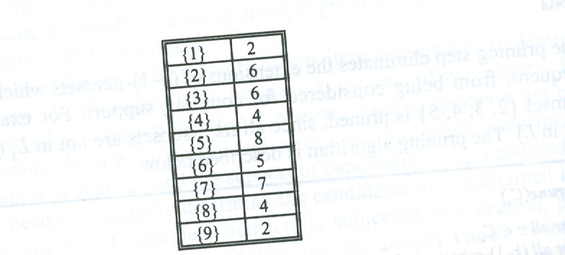
The frequent 1- item sets and their support counts are:
Mr. Shivam Pandey

Slide 28
Illustration of a priori algorithm from frequent 1 item set and corresponding support count (previous slide) [ σ = 20 % ]
L1 := { {2} → 6, {3} → 6, {4} → 4, {5} → 8, {6} → 5, {7} → 7, {8} → 4 }
k = 2
In the candidate generation step, we get:
C₂ = { {2,3}, {2,4}, {2,5}, {2,6}, {2,7}, {2,8}, {3,4}, {3,5}, {3,6}, {3,7}, {3,8}, {4,5}, {4,6}, {4,7}, {4,8}, {5,6}, {5,7}, {5,8}, {6,7}, {6,8}, {7,8}
The Pruning step does not change C₂
Mr. Shivam Pandey

Slide 29
From the database, count the support of elements in C₂ :
L₂ := { {2,3} → 3, {2,4} → 3, {3,5} → 3, {3, 7} → 3, {5,6} → 3, {5,7} → 5, {6, 7} → 3
Mr. Shivam Pandey

Slide 30
k := 3
In the candidate generation step,
Combining {2,3} and {2,4} , we get {2,3,4}
Combining {3,5} and (3,7} , we get {3,5,7} and
Combining {5,6} and {5,7}, we get {5,6,7}
Thus C₃ := {{2,3,4}, {3,5,7}, {5,6,7}}
Mr. Shivam Pandey

Slide 31
The pruning step prunes {2,3,4} as one of its subset {3,4} is of size 1 (which is less than 2; which makes σ =20%).
Thus the pruned C₃ is
{{3,5,7}, {5,6,7}}
Mr. Shivam Pandey

Slide 32
Read the database to count the support of the item sets in C₃ [ σ = 20% ]
L₃ := {{3,5,7} → 3}
k := 4
Since L₃ contains only one element, C₄ is empty and hence the algorithm stops, returning the set of frequent sets along with their respective support values. The set is:
L := L₁ U L₂ U L₃
Mr. Shivam Pandey

Slide 33
End of Association Rules
Mr. Shivam Pandey

